Slide 1

Introduction to Dynamic Web Content
Charles Severance
www.wa4e.com
Notes:
Note from Chuck. If you are using these materials, you can remove my name and URL from this replace it with your own, but please retain the CC-BY logo on the first page as well as retain the entire last page when you remix and republish these slides.

Slide 2
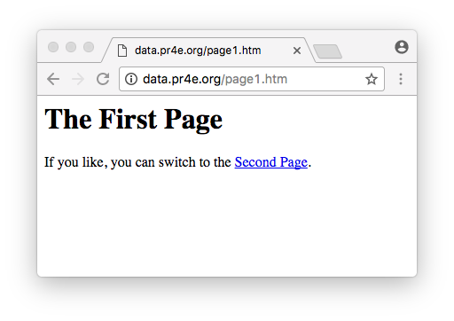

Browser
HTML
CSS
DOM
JavaScript
JQuery
Web Server
PHP
MySQL
http://data.pr4e.org/page1.htm

Slide 3
HTTP - Hypertext Transfer Protocol
The dominant Application Layer Protocol on the Internet
Invented for the Web - to retrieve HTML, Images, Documents, etc.
Extended to handle data in addition to documents - RSS, Web Services, etc.
Basic Concept: Make a connection - Request a document - Retrieve the document - Close the connection
http://en.wikipedia.org/wiki/Http

Slide 4
Uniform Resource Locator
http:// www.dr-chuck.com /page1.htm
protocol
host
document

Slide 5
Getting Data from the Server
Each time the user clicks on an anchor tag with an href = value to switch to a new page, the browser makes a connection to the web server and issues a “GET” request - to GET the content of the page at the specified URL.
The server returns the HTML document to the browser, which formats and displays the document to the user.

Slide 6
Web Server
80
Browser
Browser

Slide 7
Web Server
80
Browser
Click

Slide 8
Request
Web Server
80
GET http://data.pr4e.org/page2.htm
Browser
Click

Slide 9
Request
Web Server
Response
80
<h1>The Second Page</h1><p>If you like, you can switch back to the <a href="page1.htm">First Page</a>.</p>
GET http://data.pr4e.org/page2.htm
Browser
Click

Slide 10
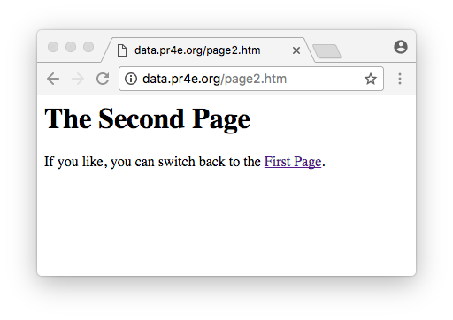
Request
Web Server
Response
80
<h1>The Second Page</h1><p>If you like, you can switch back to the <a href="page1.htm">First Page</a>.</p>
GET http://data.pr4e.org/page2.htm
Browser
Click
Parse/
Render

Slide 11
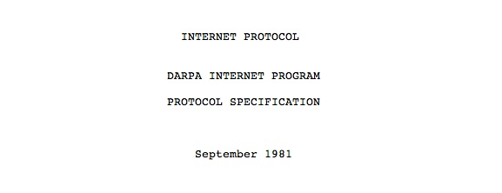
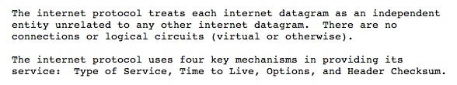
Internet Standards
The standards for all of the Internet protocols (inner workings) are developed by an organization
Internet Engineering Task Force (IETF)
www.ietf.org
Standards are called “RFCs” - “Request for Comments”
Source: http://tools.ietf.org/html/rfc791

Slide 12
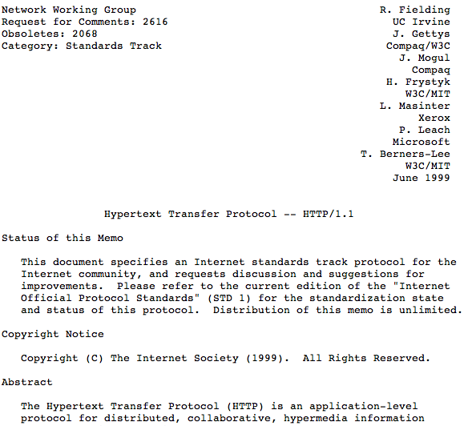
http://www.w3.org/Protocols/rfc2616/rfc2616.txt

Slide 13
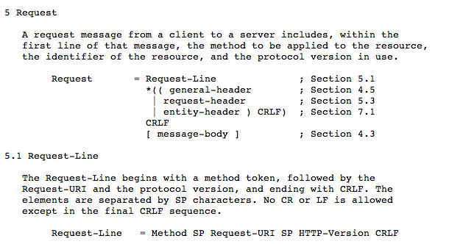

Slide 14
Request/Response Cycle

Slide 15
Making an HTTP Request
Connect to the server like www.dr-chuck.com
      - a “handshake”
Request a document (or the default document)
      GET http://data.pr4e.org/page1.htm HTTP/1.0
  Fewer and fewer servers support the “old way”

Slide 16
Web Server
$ telnet data.pr4e.org 80
Trying 192.241.136.170...
Connected to data.pr4e.org.
Escape character is '^]'.
GET http://data.pr4e.org/page1.htm HTTP/1.0
HTTP/1.1 200 OK
Date: Tue, 30 May 2017 18:08:52 GMT
Server: Apache/2.4.7 (Ubuntu)
Last-Modified: Mon, 15 May 2017 11:11:47 GMT
Content-Type: text/html
<h1>The First Page</h1>
<p>If you like, you can switch to
the <a href="http://www.dr-chuck.com/page2.htm">Second
Page</a>.</p>
Connection closed by foreign host.
Browser

Slide 17

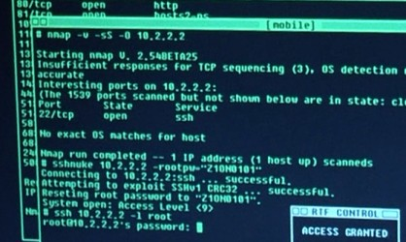
Accurate Hacking in the Movies
Matrix Reloaded
Bourne Ultimatum
Die Hard 4
...
http://nmap.org/movies.html

Slide 18
Getting to Know Our Browsers

Slide 19
Find Developer Mode
Chrome: View > Developer
FireFox: https://getfirebug.com/
Safari: Preferences > Advanced > Show Develop Menu

Slide 20
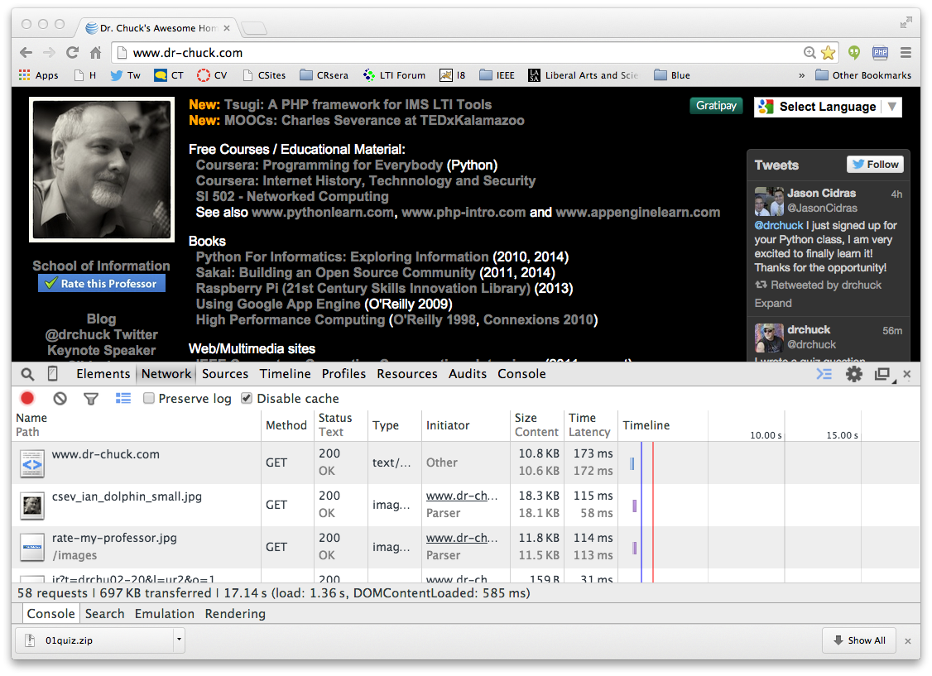
DEMO

Slide 21
This is Only the Beginning…
In the Browser – HTML, CSS, Document Object Model (the DOM) and JavaScript
In the Web Server – Apache (or similar) web server with a PHP extension installed
In the Database Server running MySQL - PostgreSQL, Oracle, SQL Server, or similar

Slide 22

Time
Browser
Web Server
Database Server
DOM
Apache
static
files
MySql
Parse
Request
Parse
Response
PHP
php
code
JavaScript
RRC/HTTP
SQL

Slide 23
Summary
Many modern web applications use a stack of open source software working together.
While you can use frameworks to accelerate productivity, this course focuses on what is really going on so you can fully understand what frameworks are doing on your behalf.

Slide 24
Acknowledgements / Contributions
These slides are Copyright 2010- Charles R. Severance (www.dr-chuck.com) as part of www.wa4e.com and made available under a Creative Commons Attribution 4.0 License. Please maintain this last slide in all copies of the document to comply with the attribution requirements of the license. If you make a change, feel free to add your name and organization to the list of contributors on this page as you republish the materials.
Initial Development: Charles Severance, University of Michigan School of Information
Insert new Contributors and Translators here including names and dates
Continue new Contributors and Translators here
Notes:
Note from Chuck. Please retain and maintain this page as you remix and republish these materials. Please add any of your own improvements or contributions.

